Slide 1
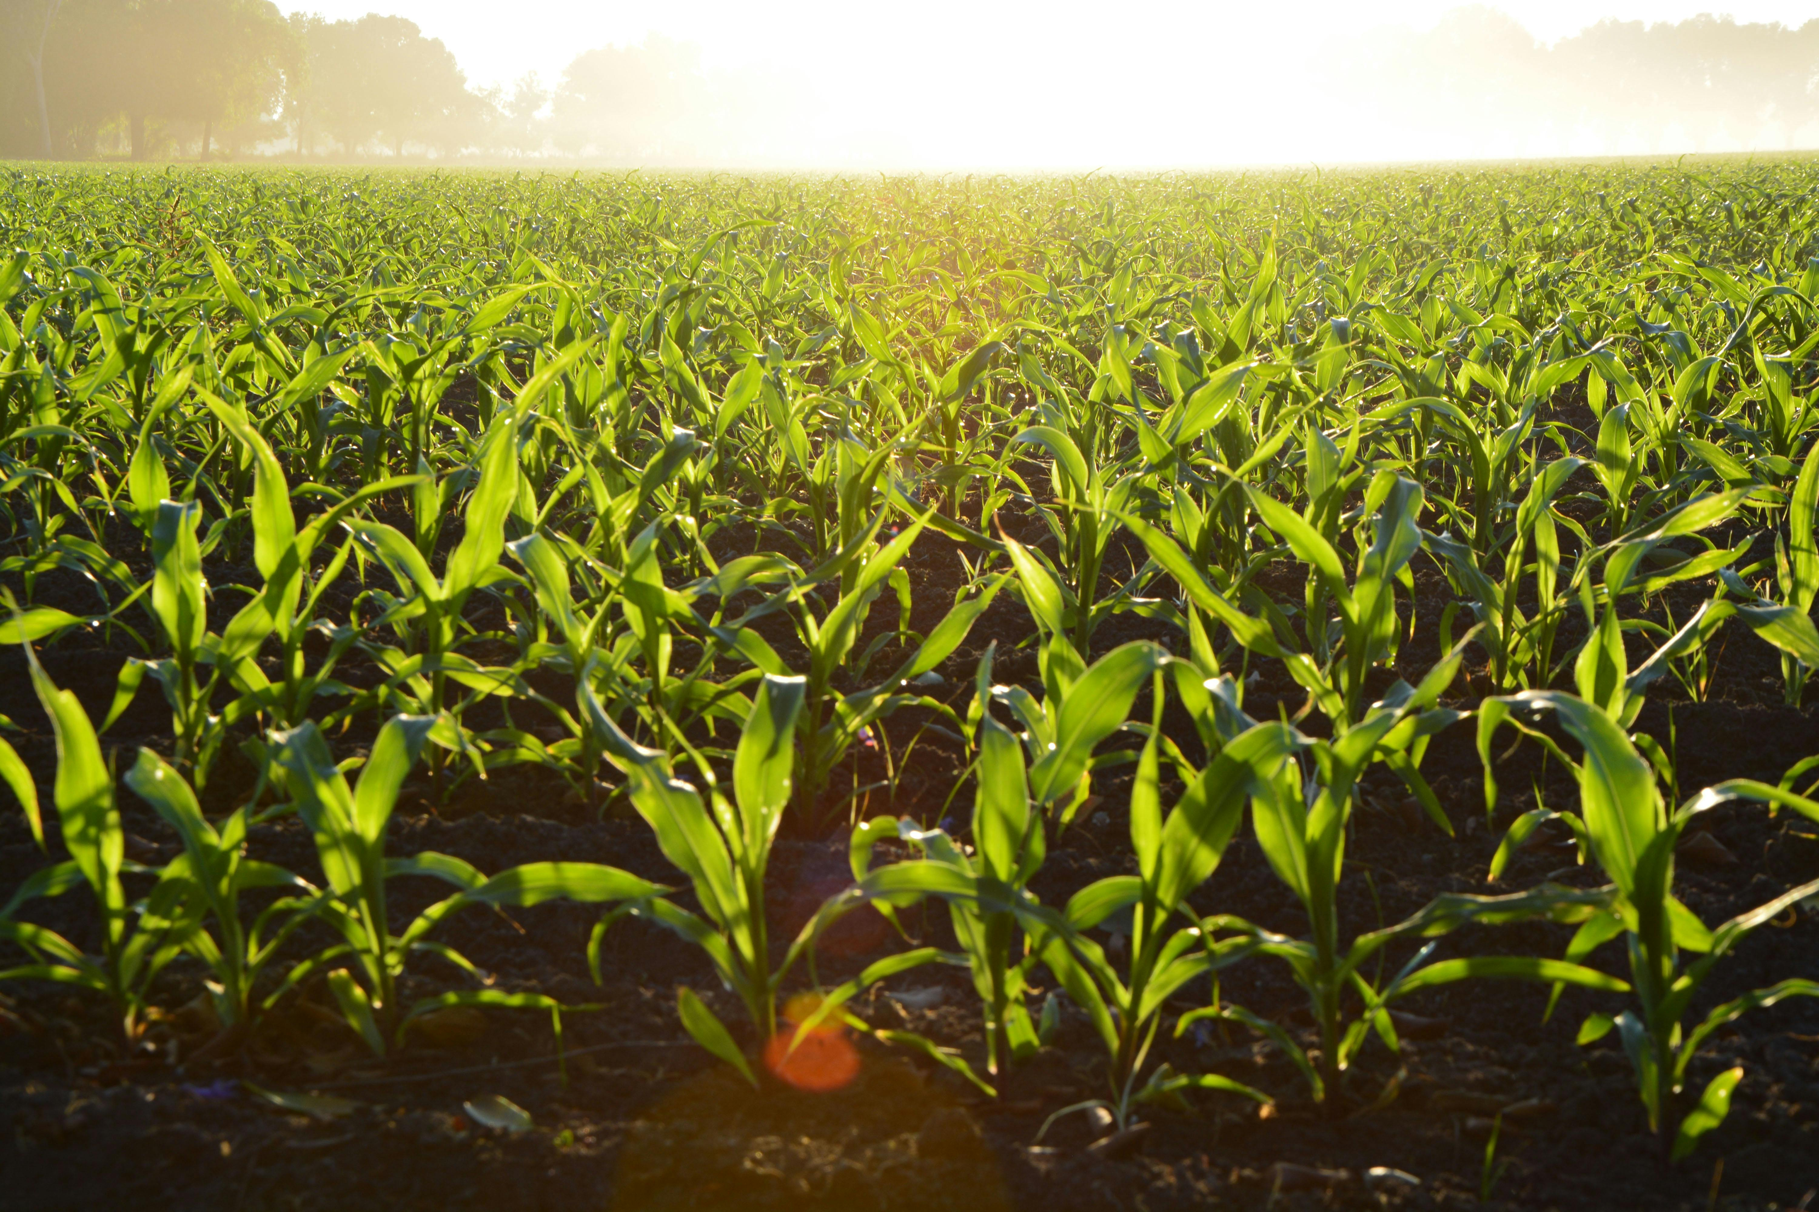
USDA PLANT
HARDINESS ZONES
Climate Change and Impacts on Agricultural
Crops in the Kentucky-West Virginia-Ohio Region
Megan Howard – Cohort 11
Notes:
Hello everyone. My name is Megan Howard, and today I’ll be presenting “USDA Plant Hardiness Zones - Climate Change and Its Impacts on Agricultural Crops in the Kentucky–West Virginia–Ohio Region.” We’ll look at how climate change is shifting USDA growing zones, influencing weather patterns, and affecting key crops like corn and soybeans.

Slide 2
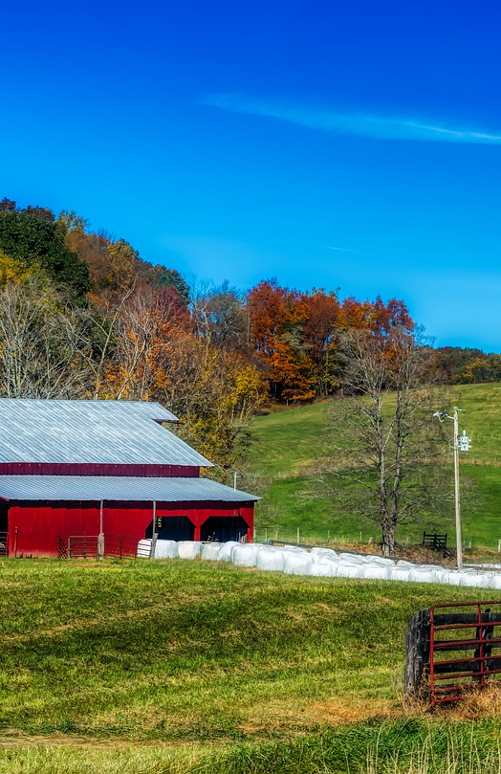
Goals
Explain USDA Growing Zones and their use in farming and agriculture
Examine temperature trends that have spurred recent change in zones
Predict future temperature patterns
Look at crop impacts in tri-state region
Notes:
My goals for this project are to explain the USDA zones and their use in farming and agriculture; examine the changing temperature trends that have caused the recent shift in the growing zones in our area; look at predictions for future weather patterns; and to examine crop impacts in the tri-state region and suggest ways farmers can adapt as we continue to see these changes.

Slide 3
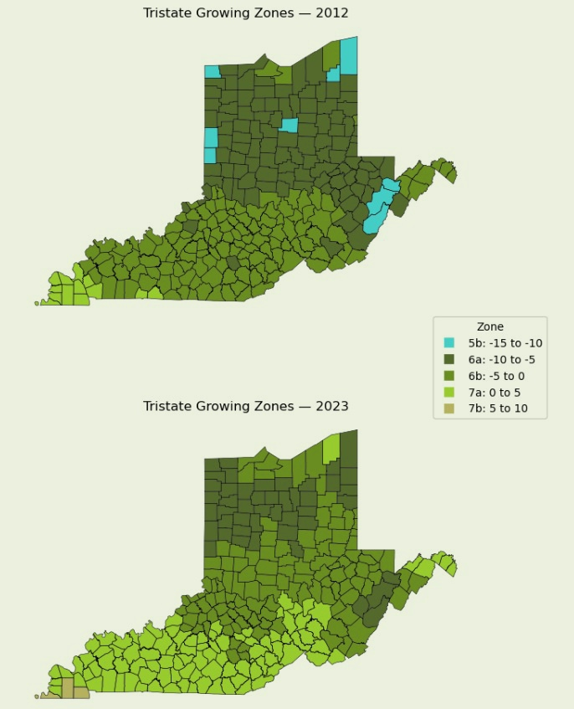



Understanding USDA Growing Zones
Based on annual extreme minimum temperatures
Help farmers and gardeners choose winter-hardy plants
Zone shifts reflect climate change over time
Notes:
The USDA plant hardiness zones are based on annual extreme minimum temperatures — in other words, the coldest days of winter. Zone number labels are assigned using a scale of 10-degree increments, then further divided into “a” or “b” by 5 degrees. For example – zone 6b, a common zone for the region, is based on extreme minimum temperatures of -5 to 0 degrees Fahrenheit. These zones help farmers and gardeners determine which crops or plants can survive local winters. The maps here show how the zones have shifted from 2012 to the most recent update in 2023.
Why is this important? Growing zones are the foundation of agricultural planning – they determine what crops farmers can plant, and when. A shift of even half a zone can mean new pests, earlier bloom times, and changing crop viability. Tracking shifts gives tangible evidence of climate change, something that farmers area already experiencing on the ground. It connects science to real-world decision making for farmers, making it essential for climate adaptation plans in the region.

Slide 4

Average Temperature Increase
2.25
%
From 1990 – 2024 in tri-state region
Regional Zone Changes 2012 - 2023
47.9
%
Shifted to warmer zone
46.1
%
Unchanged
6
Shifted to cooler zone
%
Extreme Minimum Temp Increase
5.04
%
This metric is used to determine
growing zones
Notes:
Here is an overview of some of the meaningful numbers I’ll explore in the presentation. There has been an average overall temperature increase of 2.25% in the region from 1990 to 2024. Even more importantly, the extreme minimum temperatures have risen roughly 5%, causing the recent shift in zones – nearly 48% of the tri-state region has shifted to a warmer USDA zone since 2012, while about 46% remained unchanged and a smaller 6% shifted to a cooler zone. This change might not sound too dramatic, but for farmers this can redefine how they operate.

Slide 5
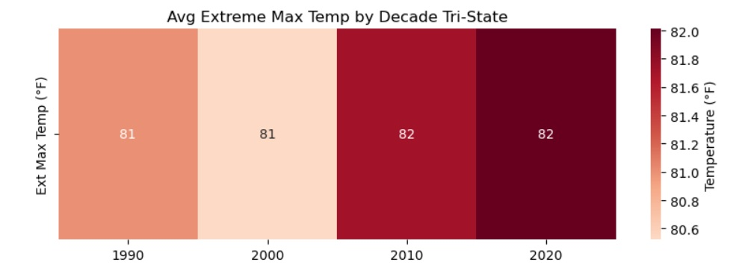
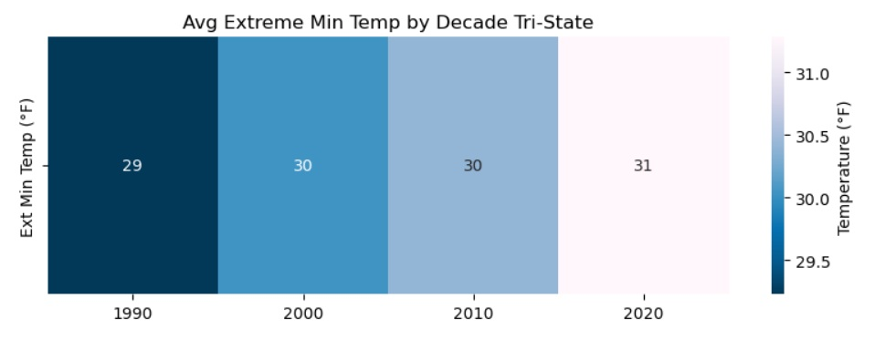
Temperature Trends
Hotter
Summers
Milder Winters
Notes:
When we look at regional data from 1990 to 2024, average maximum and minimum temperatures are rising. Extreme minimum temperatures — those coldest days — have increased by around 5%, which is more than twice the rate of extreme maximum temperature rise. This tells us winters are becoming milder, which directly affects zone classification and crop survival patterns.

Slide 6

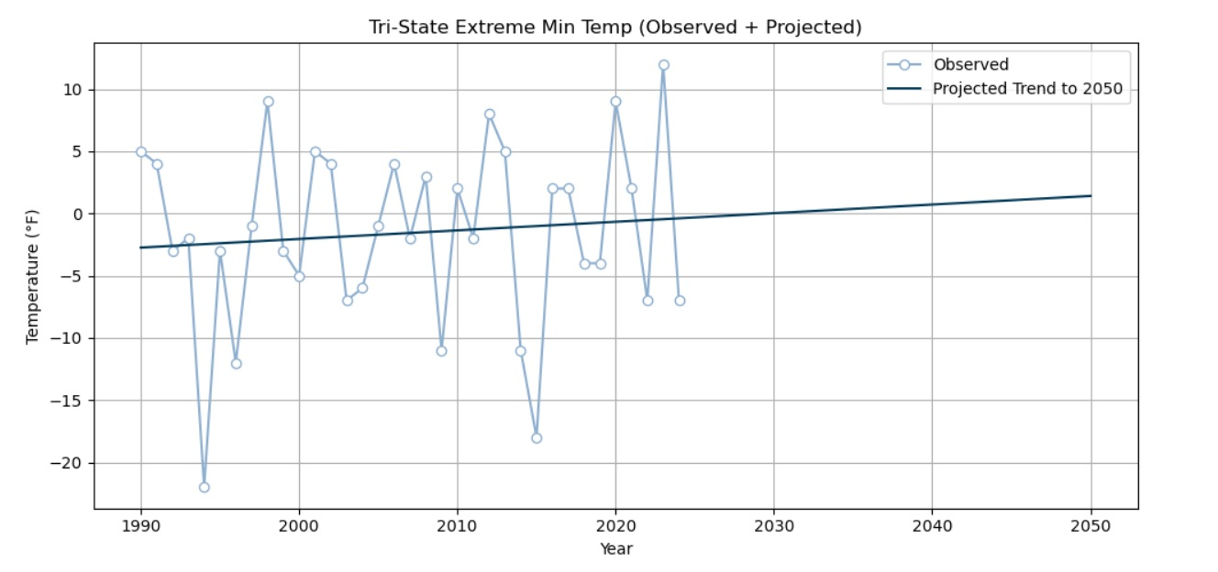
EXTREME MINIMUM TEMPERATURE PREDICTIONS TO 2050
Notes:
Looking ahead, projections for extreme minimum temperatures suggest continued warming. By 2050, much of the tri-state area could resemble today’s southern Kentucky zones. This means longer growing seasons — but also new challenges like earlier pest emergence and heat stress during pollination.

Slide 7

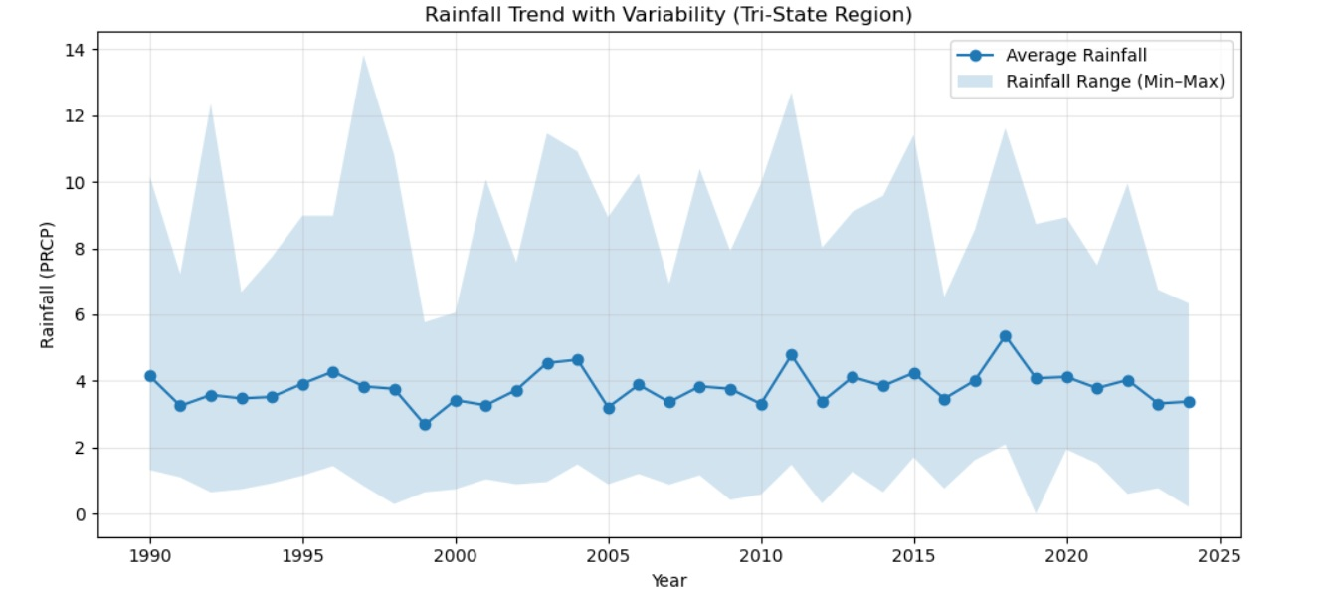
Notes:
Rainfall totals across the region have remained fairly consistent, but variability is rising. Wet years are getting wetter, dry years are drier — leading to less predictability for planting and harvest windows. This variability can increase both flooding and drought risks within the same decade.

Slide 8
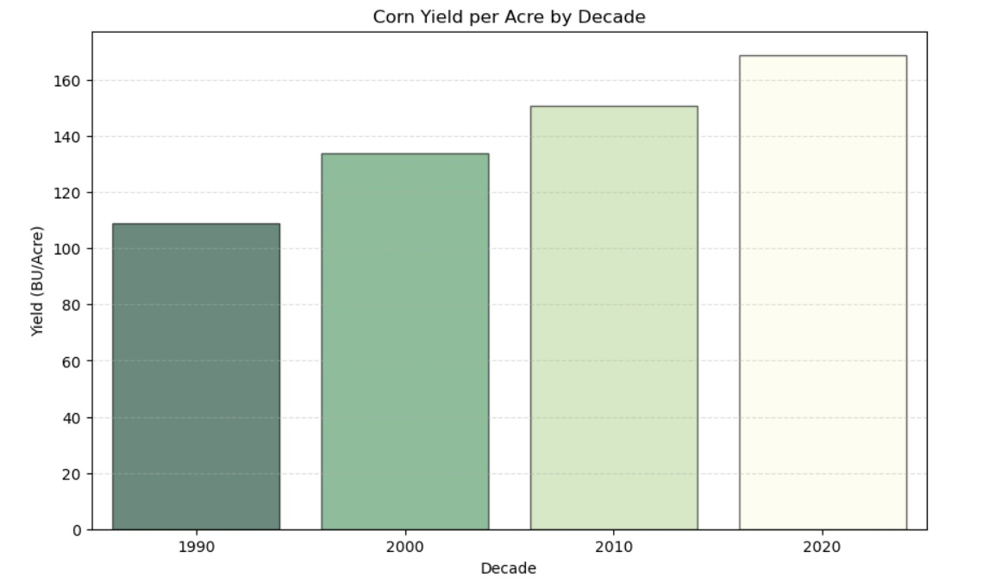
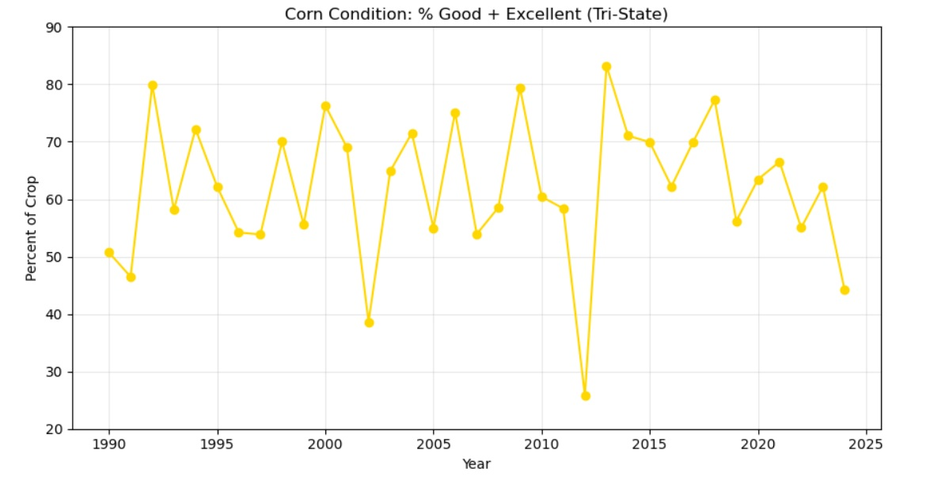
Corn Yield & Condition (Tri-State Region)
Rising yields over recent decades
Variable conditions reflect weather extremes
Crop resilience remains strong overall
Notes:
Corn yields have risen steadily over the decades, thanks to better hybrids and technology, as well as longer and earlier growing seasons. However, crop condition — the percent rated Good to Excellent — fluctuates significantly year to year. This reflects how weather volatility, especially drought and heat spikes, continues to impact crop performance.

Slide 9
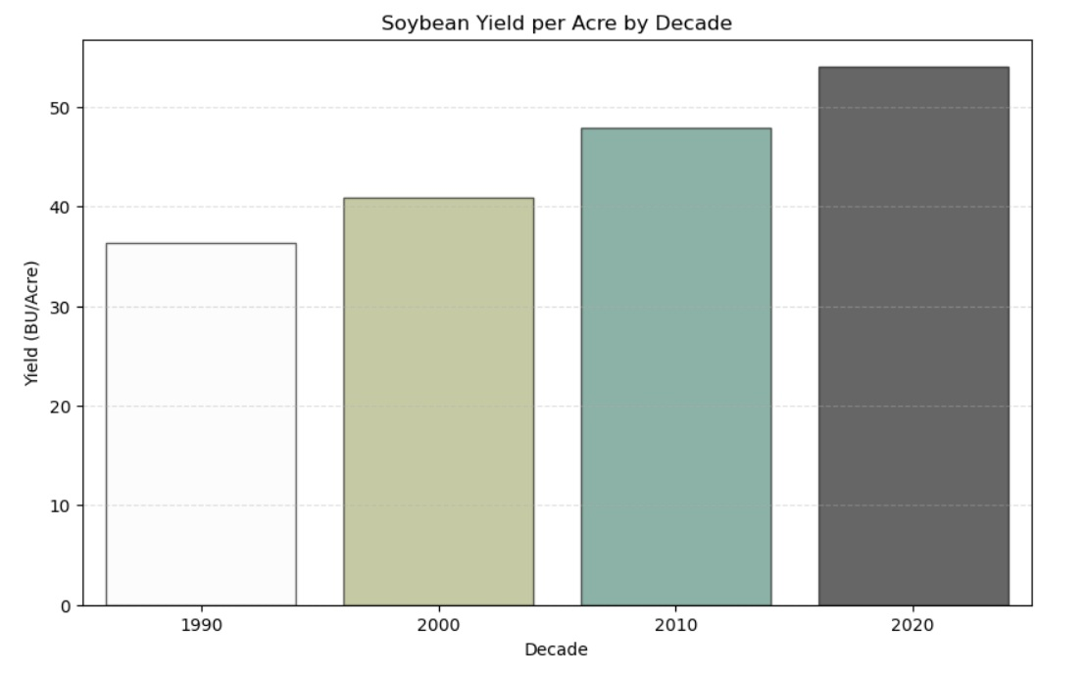
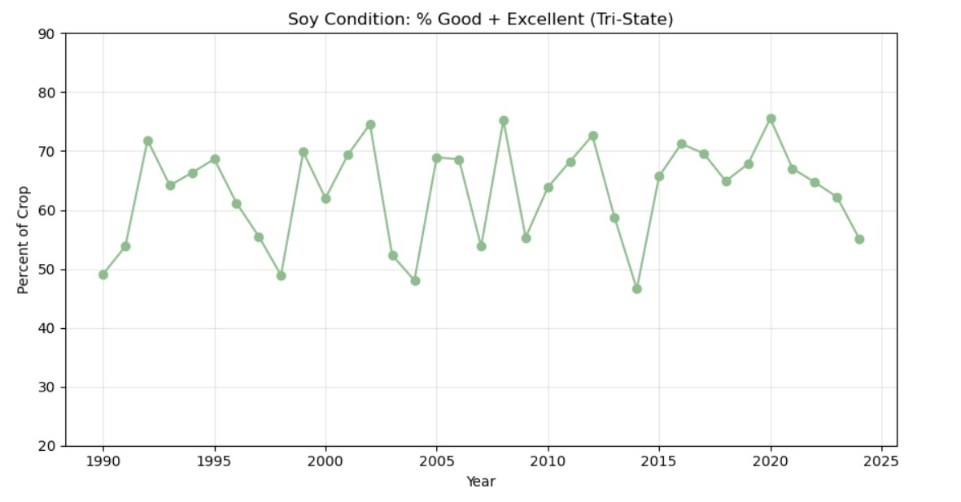
Soy Yield & Condition (Tri-State Region)
Yields rising steadily across decades
Conditions vary widely year to year
Resilient trend despite fluctuations
Notes:
Soybeans show a similar trend: steady long-term yield growth, but condition ratings vary annually. Soybeans tend to be more resilient than corn, but both crops show how adaptation has helped maintain productivity despite climate stress.

Slide 10




Summary
7a
6b
Notes:
To summarize —
The tri-state region has experienced a measurable northward shift in USDA growing zones between 2012 and 2023 — with about 48% of areas shifting to a warmer zone.
These shifts correspond closely with rising minimum temperatures, which have increased by about 5% since 1990, more than double the rate of increase for overall temperature averages.
Rainfall is more erratic, though totals remain stable. This volatility adds uncertainty for farmers and can affect yield and condition consistency.
Corn and soybean resilience remains strong overall, but vulnerability to extreme weather events is increasing.

Slide 11
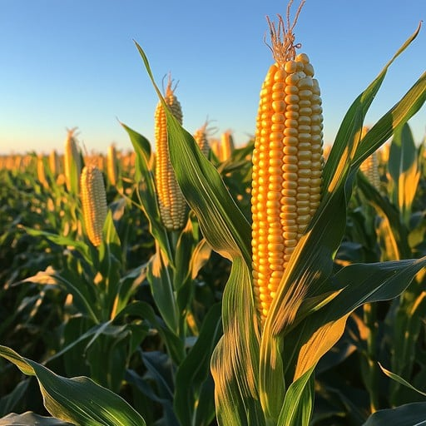





Recommendations
Support Farmers
Early Warning
Diversify Crops
Cooperation
Healthy Soil
Notes:
Based on these findings, here are a few key recommendations:
Support adaptive, climate-smart farming — with drought-tolerant seeds, efficient irrigation, and flexible planting windows.
Invest in early warning and monitoring systems to help farmers predict heat and rainfall extremes.
Diversify crop portfolios by encouraging experimentation with warm-adapted crops or cultivars, which could thrive under the predicted future warming conditions.
Encourage regional cooperation among Kentucky, Ohio, and West Virginia to develop shared adaptation strategies.
Promote soil health practices that protect yield and store carbon. Increasing incentives for practices such as cover cropping and reduced tillage can help maintain agricultural resilience as the region continues to warm.
Thank you for listening. The tri-state region has shown incredible adaptability so far — but as we look ahead to 2050, that adaptability will be more important than ever. I’ll be happy to take any questions.

